Slide 1


SPRING VALLEY VILLAGE POLICE DEPARTMENT
MONTHLY NEWSLETTER:
JULY 2026
1025 CAMPBELL ROAD
HOUSTON, TX 77055
PHONE: 713-465-8323
COMMUNITY MATTERS.
WE ARE A TEAM.

Slide 2

INTRODUCTION
Hilshire Village Residents,
Happy 250th Birthday America!
On July 4, 1776, the Declaration of Independence was officially implemented, marking the birth of the United States of America. As you celebrate Independence Day with family, friends, food, and fireworks, we encourage you to reflect on the inception of our country and its core values.
KEEP IN MIND:
  Fireworks are not permitted within the city limits of Hilshire Village.
  Lock your vehicle when it is unoccupied.
  Be sure to lock all doors and windows in your home, when you are not on the premises.
Remember we are always here if you need us!
Sincerely,
Chief M. Schulze
1025 CAMPBELL ROAD, HOUSTON, TX 77055
PHONE: 713-465-8323 / EMAIL: DISPATCH@SPRINGVALLEYTX.COM

Slide 3


JULY 2026
DATE | DAY | SPECIAL DAYS FOR THIS MONTH
07-03-2026 | FRIDAY | CITY HALL CLOSED
07-04-2026 | SATURDAY | FOURTH OF JULY
COMMUNITY MATTERS.
WE ARE A TEAM.
1025 CAMPBELL ROAD, HOUSTON, TX 77055 / PHONE: 713-465-8323 / EMAIL: DISPATCH@SPRINGVALLEYTX.COM

Slide 4


COMMUNITY MATTERS.
WE ARE A TEAM.
1025 CAMPBELL ROAD, HOUSTON, TX 77055 / PHONE: 713-465-8323 / EMAIL: DISPATCH@SPRINGVALLEYTX.COM

Slide 5

COMMUNITY MATTERS.
WE ARE A TEAM.
1025 CAMPBELL ROAD, HOUSTON, TX 77055 / PHONE: 713-465-8323 / EMAIL: DISPATCH@SPRINGVALLEYTX.COM

Slide 6

COMMUNITY MATTERS.
WE ARE A TEAM.
1025 CAMPBELL ROAD, HOUSTON, TX 77055 / PHONE: 713-465-8323 / EMAIL: DISPATCH@SPRINGVALLEYTX.COM

Slide 7
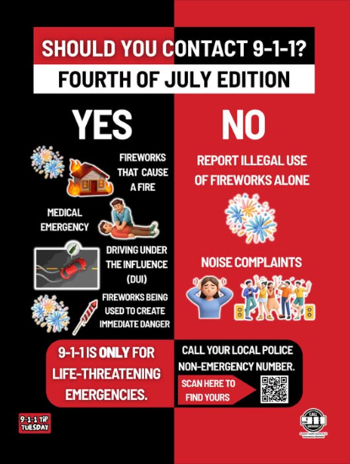
COMMUNITY MATTERS.
WE ARE A TEAM.
1025 CAMPBELL ROAD, HOUSTON, TX 77055 / PHONE: 713-465-8323 / EMAIL: DISPATCH@SPRINGVALLEYTX.COM

Slide 8


COMMUNITY MATTERS.
WE ARE A TEAM.
1025 CAMPBELL ROAD, HOUSTON, TX 77055 / PHONE: 713-465-8323 / EMAIL: DISPATCH@SPRINGVALLEYTX.COM

Slide 9
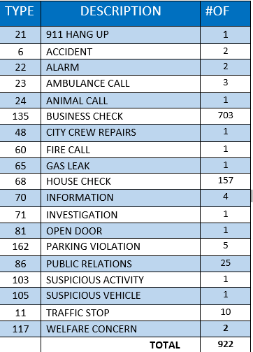
SPRING VALLEY POLICE DEPARTMENT
HILSHIRE VILLAGE
CALLS BY TYPE: 06-01-2026 THRU 06-30-2026
COMMUNITY MATTERS.
WE ARE A TEAM.
1025 CAMPBELL ROAD, HOUSTON, TX 77055
PHONE: 713-465-8323 / EMAIL: DISPATCH@SPRINGVALLEYTX.COM

Slide 10
IMPORTANT NUMBERS AT A GLANCE
EMERGENCY |  | NON - EMERGENCY
911 - FOR ALL EMERGENCY |  | 713-465-8323
988 – NATIONAL SUICIDE & MENTAL HEALTH
SPRING VALLEY VILLAGE |  | VILLAGE FIRE DEPARTMENT
SPRING VALLEY - CITY HALL | 713-465-8308 | VILLAGE FIRE DEPARTMENT |  | 713-465-2323
SPRING VALLEY - PD | 713-465-8323 | VFD - NON-EMERGENCY |  | 713-468-7941
SPRING VALLEY - PD FAX | 713-465-3135
SPRING VALLEY - COURT | 713-465-0333
HILSHIRE VILLAGE
HILSHIRE VILLAGE – CITY HALL | 713-973-1779
COMMUNITY MATTERS.
WE ARE A TEAM.
1025 CAMPBELL ROAD, HOUSTON, TX 77055 / PHONE: 713-465-8323 / EMAIL: DISPATCH@SPRINGVALLEYTX.COM

